Slide 1
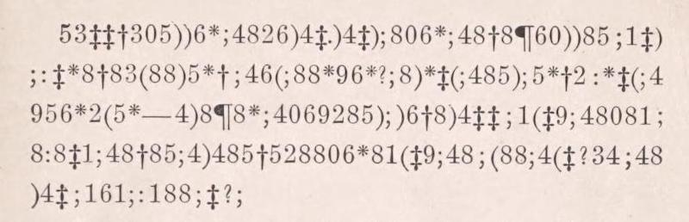
Python for Research Intro
Notes:
Hi everyone, my name is Farukh and I’m the lab tech.
Today I’ll be giving a brief overview of Python and how you can use it for research purposes.

Slide 2
Content
Why Python?
How Python?
What Python?
Resources
Notes:
So the content will be outlined in 3 simple questions “Why”, “How”, and “What”.
And here’s a meme to set the mood for this presentation.

Slide 3
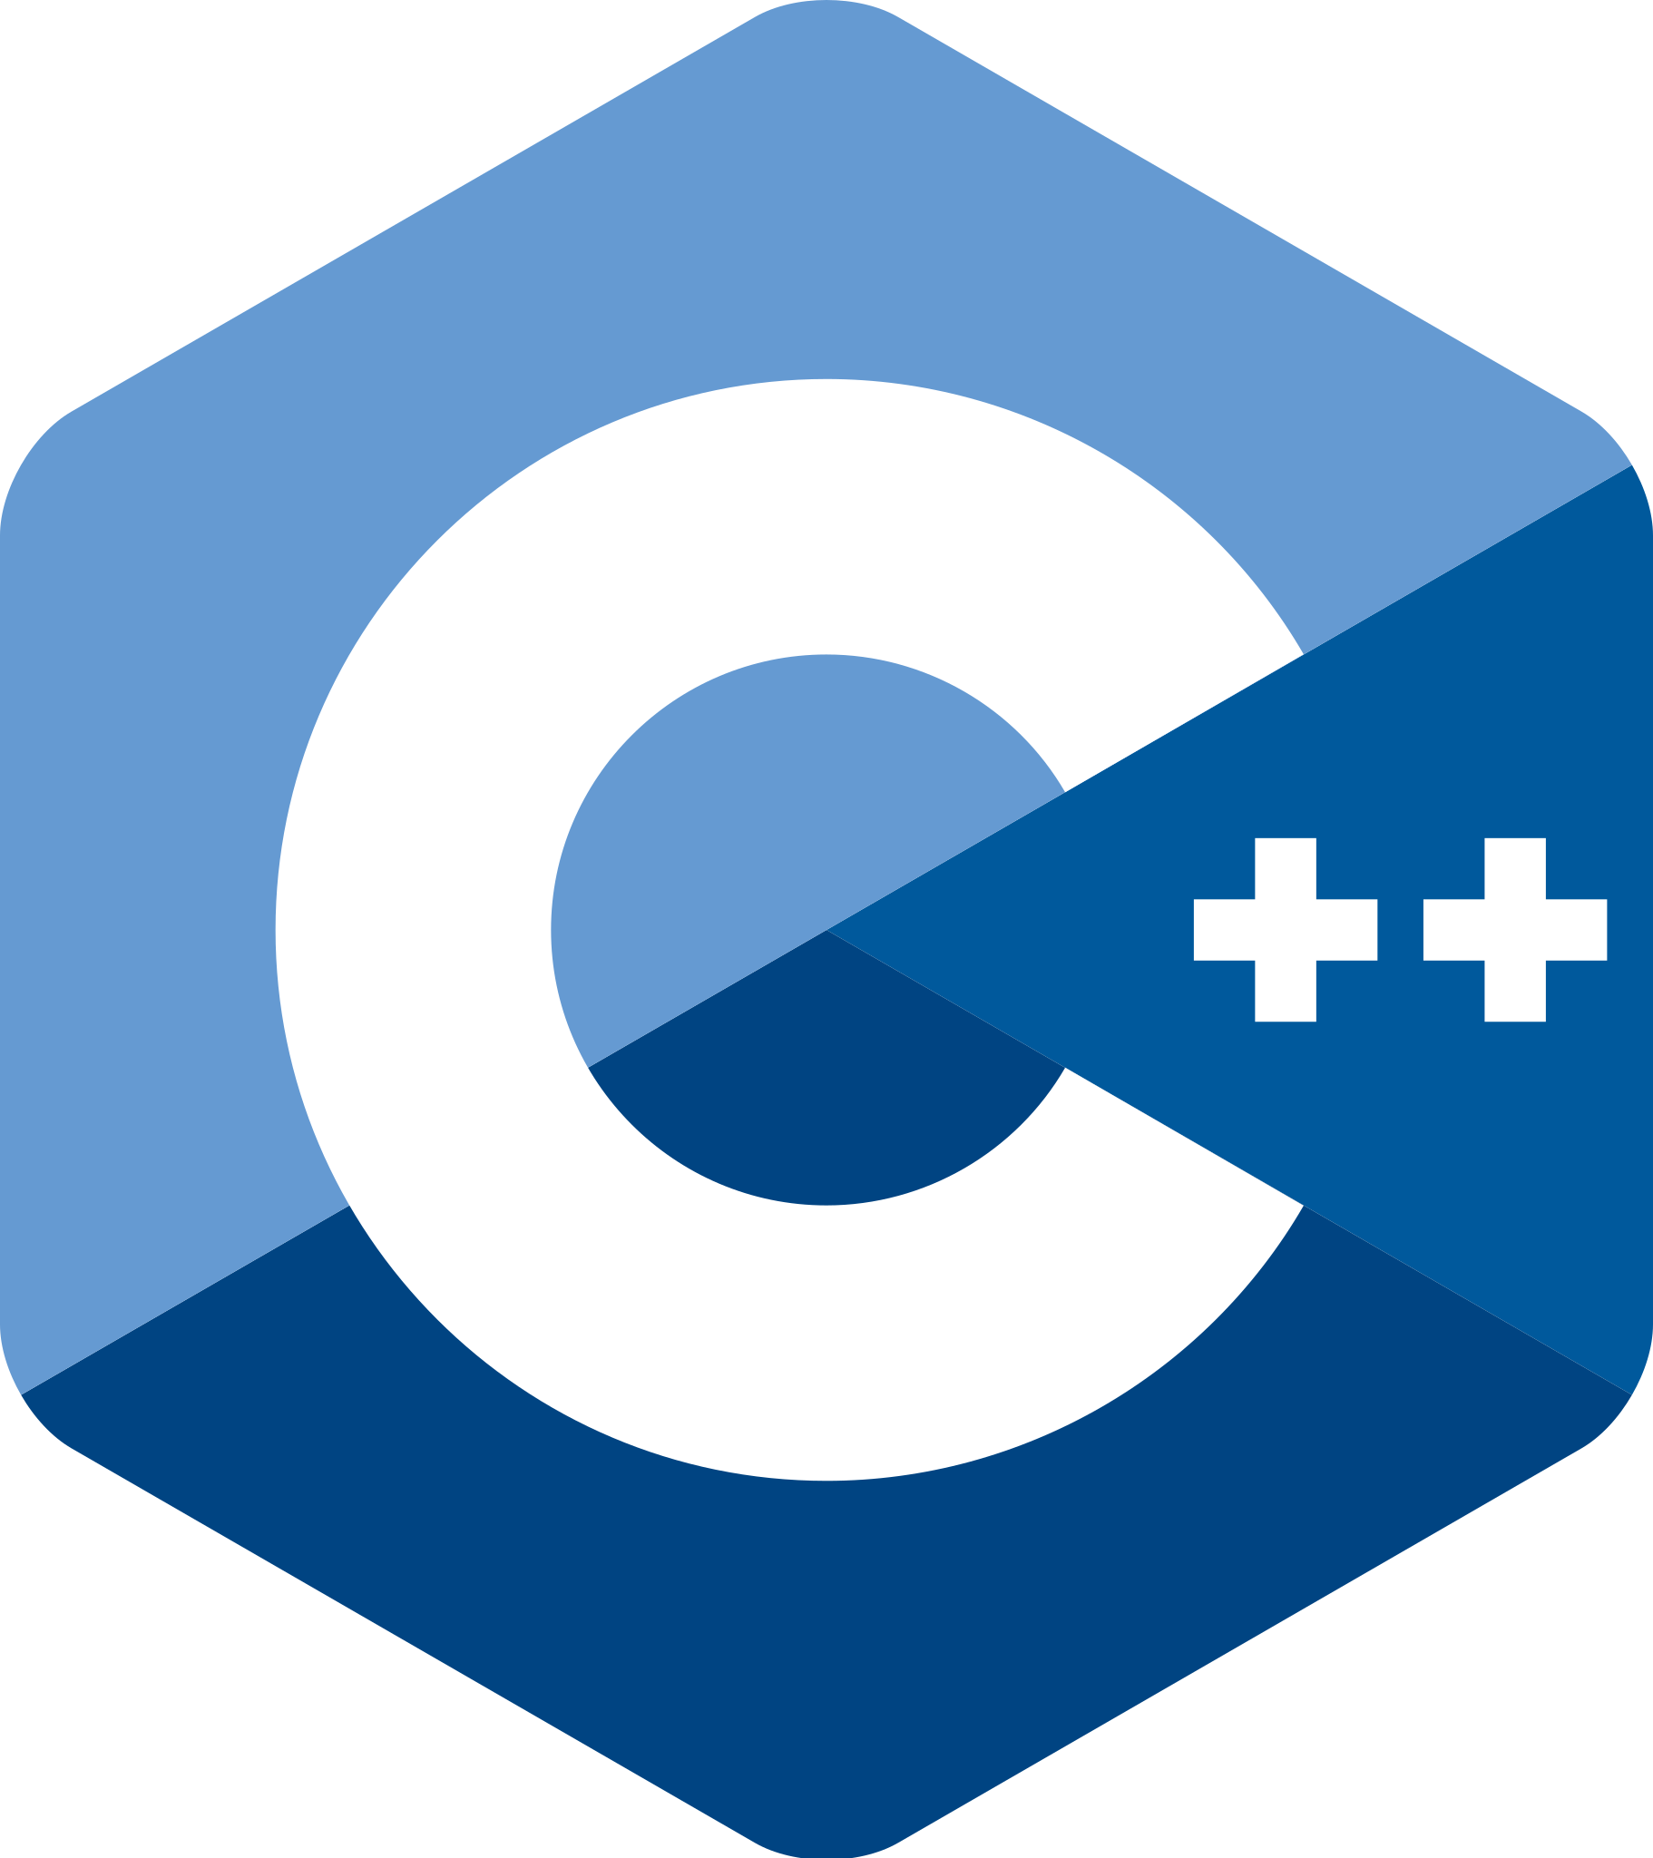

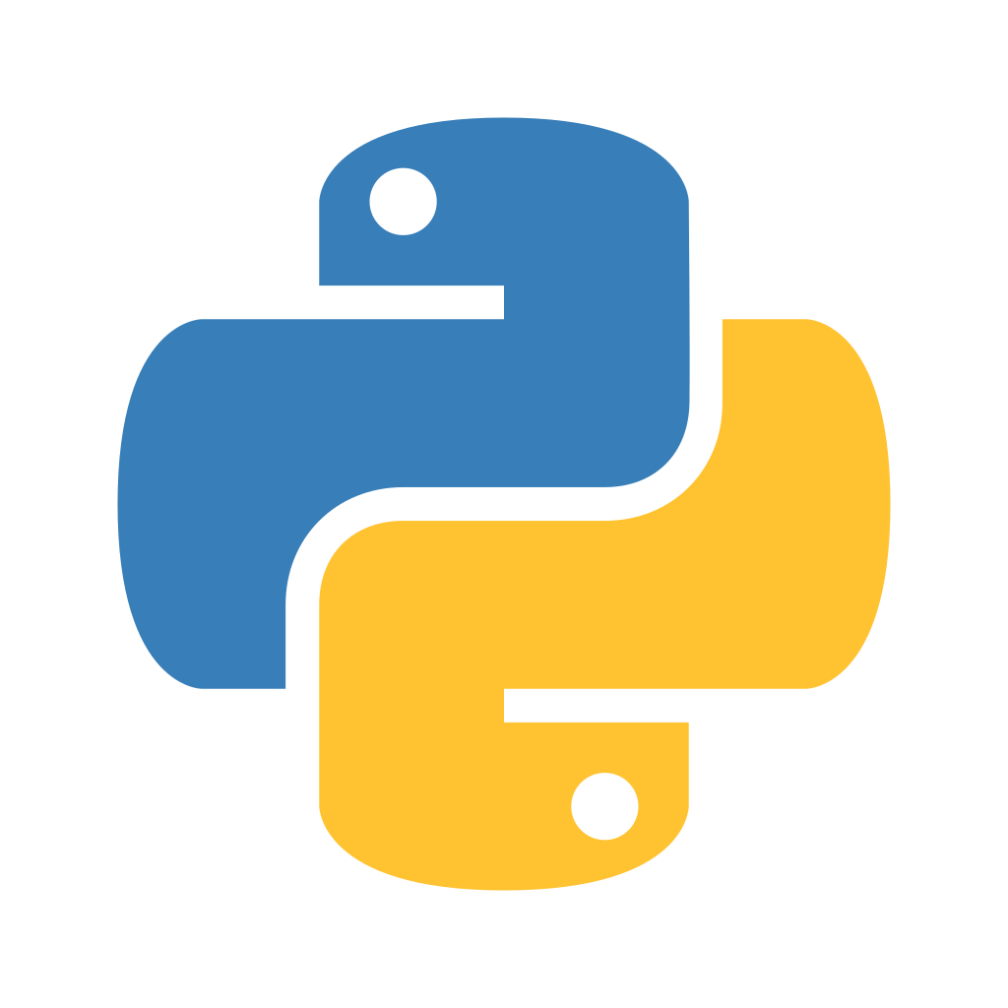
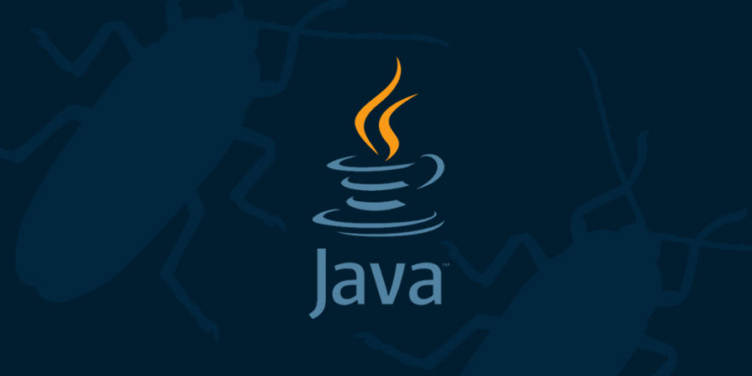
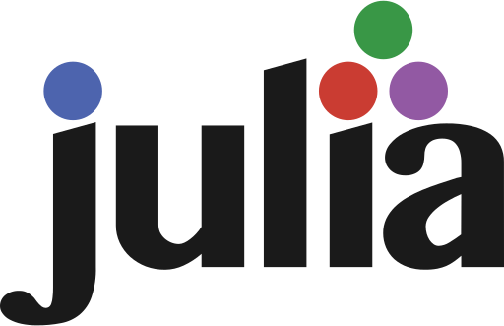
Why Python?
OOP
Computational
Science
Notes:
So why would you want to use Python?
This is a super simplified map of languages and only accurate when considering limited dimensions, but relevant for the context you all operating in.
So you can imagine programming occurring in two different spaces: the object-oriented space where you write software and the computational where you write out scripts for statistical analysis, which is where you all will mostly exist in.

Slide 4
Why Python?
OOP
Computational
Science
Notes:
Python exists in this sort of sweet-spot where you could potentially write out a simple script to do some quick data analysis,
Or if you want, you could incorporate it into a comprehensive testing suite with reusable components and other common OOP paradigms, much like our pepper pipeline software.
However, the same could occur in R (maybe Julia too).

Slide 5
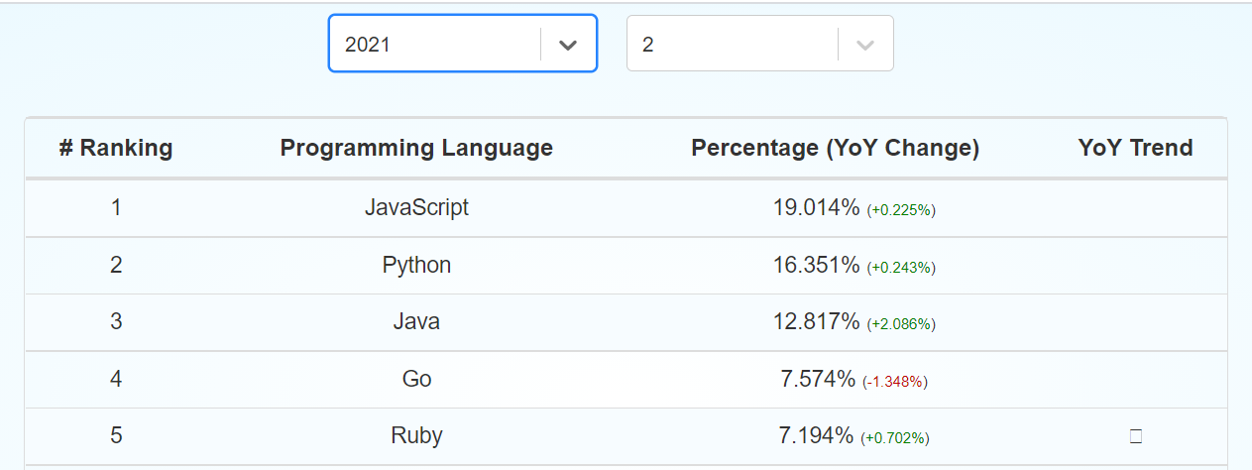
Figure 1. GitHub repo statistics
Notes:
And not only that, but Python is a pretty widely used language across GitHub repos when it does come to these software oriented languages.
And generally OOP concepts are often easy to understand across languages. It’s not like real human languages, where speaking Hungarian does not mean you will necessarily understand Mandarin and vice versa.
However, there are exceptions to this rule.

Slide 6
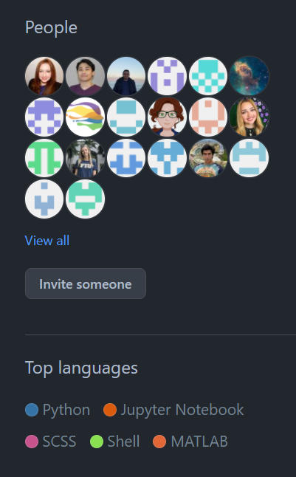
Figure 2. Python in NDC
Notes:
And also it’s currently the most-used language in the lab, so maybe it will help when you need to understand the software tools that we use.

Slide 7
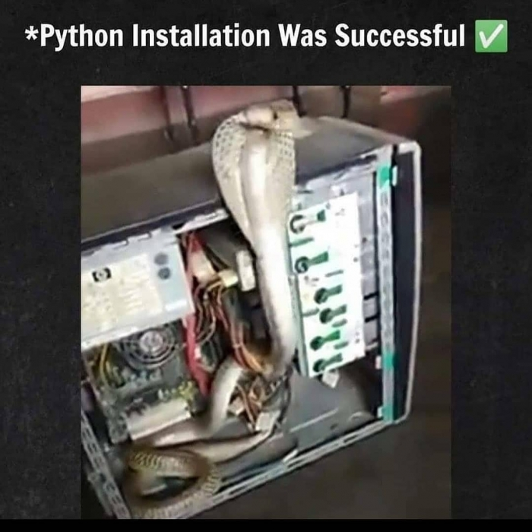
How Python?
Download Python to your PC
Verify w/ python --version
Comes installed w/Mac
Must be installed on Windows
Notes:
So how do you start using python.
You first need to verify that you have “python” installed to your PC. On mac it comes w/but it must be installed on Windows.

Slide 8
How Python?
Get a good Integrated Development Environment (IDE)
Visual Studios (Windows)
PyCharm
XCode (Mac)
Replit.com (Web/No download)
Notes:
Next, you will need a good IDE to develop Python programs

Slide 9
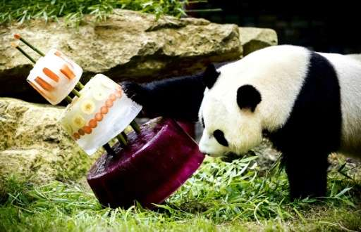
How Python?
Find packages that you want to use and consult documentation
mne
scikit-learn
pandas
Notes:
And then there are the various packages you need

Slide 10
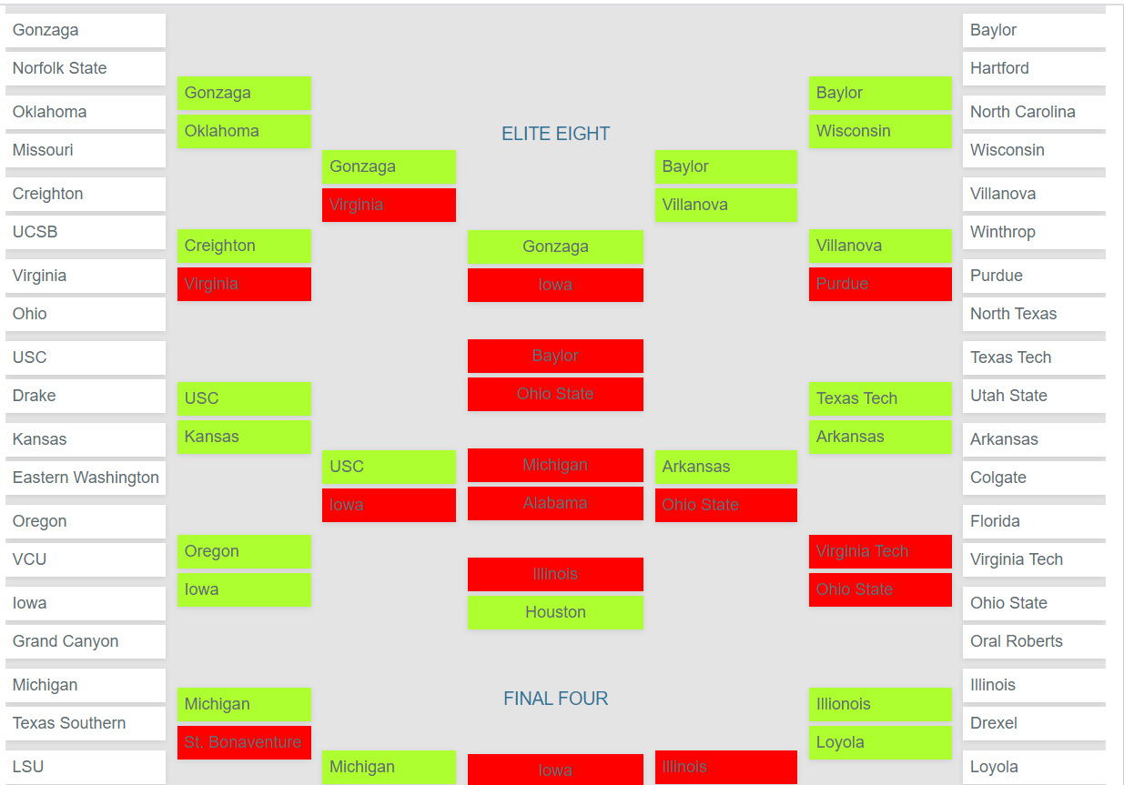
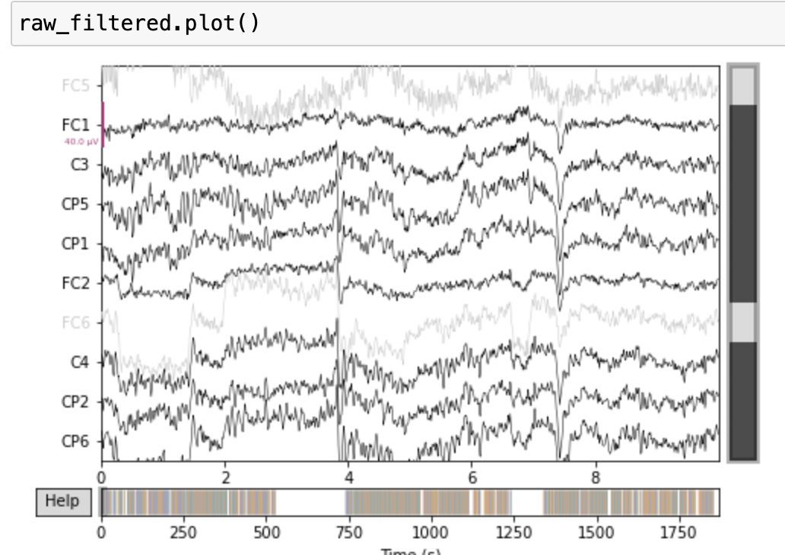
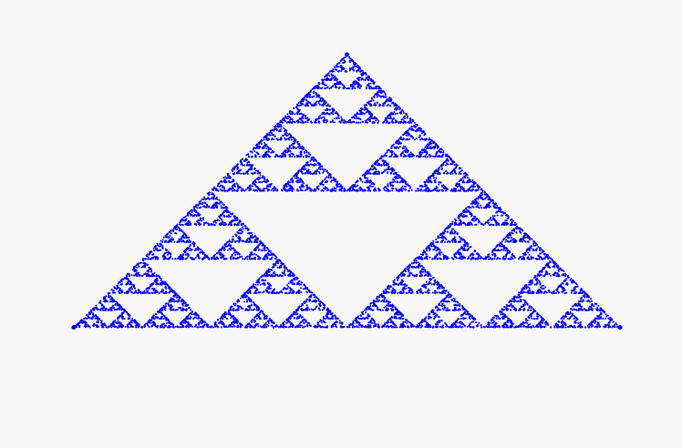
What Python?
Maths
Data Science
Data Viz.
Notes:
Python is good for many things:
Math
Data science
Data viz
And there are many comprehensive tutorials on how to use Python for these purposes.

Slide 11
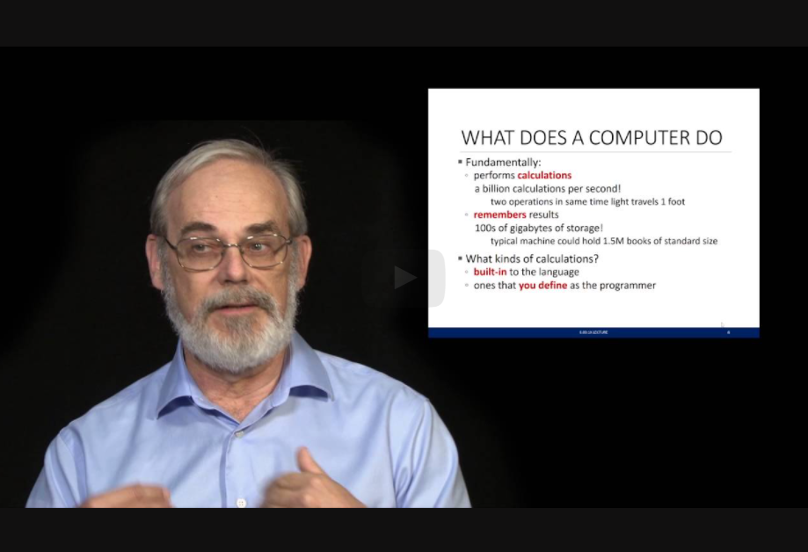

Resources
MIT Python Course
Python syntax
CS50
Data structures & algorithms
Automate the Boring Stuff Using Python
More Python syntax
Software Carpentry
From IRCC!

